Slide 1
MDEV 1005
Mobile Web Applications JavaScript ES6
Instructor: Mr. Wolski

Slide 2
JavaScript ES6 additions
Here we will be reviewing some of the concepts that JavaScript has added to its feature set in more recent years
Please try the challenges that I put forth to you as they will really make you learn the code and the way these things work!
There are many other resources out there for exploring JavaScript functionality and examples. Don’t be afraid to search for another if the one I link is not making things clear

Slide 3
For…of loop
This new feature once again bares a resemblance to other languages. It allows you to iterate over an array’s elements and do something with each element const iterable = [10, 20, 30]; for (let value of iterable) { value += 1; console.log(value); }
// 11
// 21
// 31
Note, you can also iterate over a string

Slide 4
Iterating over a map
const iterable = new Map([['a', 1], ['b', 2], ['c', 3]]);
for (const entry of iterable) {
console.log(entry);
}
// ['a', 1]
// ['b', 2]
// ['c', 3]
for (const [key, value] of iterable) {
console.log(value);
}
// 1
// 2
// 3 More examples here

Slide 5
Template Literals
If you are familiar with other programming languages (like PHP) you know it is possible to have the contents of a string be placed into another string by referencing it with a ${variableNameHere}
The most basic example would be something like: let firstName = “Mr.”; let lastName = “Wolski” console.log(`${firstName} ${lastName}`); //Mr. Wolski
Note that we are NOT using single quotes ‘ but are using the back-tick ` If you do not use the backtick the replacement will not work

Slide 6
Template Literals – Example 2
You can also perform calculations within the braces for variables with numeric values like so: let a = 5; let b = 10; console.log(`Fifteen is ${a + b} and not ${2 * a + b}.`); // "Fifteen is 15 and // not 20.“
Here is some more information and examples you should play with if you are not familiar

Slide 7
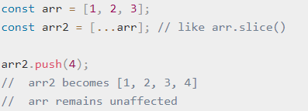
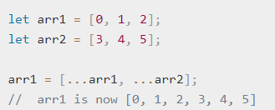
Spread Operator …
The spread operator is a new addition that makes it easy to create copies of arrays (rather than passing by reference) and also pass values from objects into other objects
You can also concatenate the values from one array into another easily

Slide 8
Rest operator function add(…nums)
The rest operator allows you to turn any number of arguments passed into a function into an array function add(...nums){
//nums is now an array we can use with the number of elements passed in
console.log(nums);
}
add(1,2,3); //[1,2,3]
add(6,1,2,3,4); //[6,1,2,3,4]
//You can also put required parameters before the rest operator function add(a, b, ...moreNumbers) {

Slide 9
Default Parameters
You can specify default parameters in your functions. This can prevent errors when values are not passed in. Simply use the = in the function declaration to assign a default value function createRectangle(w = 100, h = 50){ //now if someone does not pass in a height a default is used instead of undefined } As usual, you can see more examples here

Slide 10
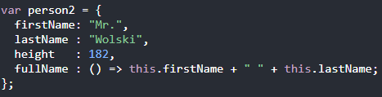
Arrow Functions
With arrow functions you have to type less to define functions, but you do lose the this keyword within the function
This means you should not use them within objects
You can check out some ways to write arrow functions here or here
Won’t work! this is not available in arrow functions

Slide 11
Examples of concepts
If you want to play around with some of these concepts you can check out the following code
Modify the functions, delete the contents and see if you can re-write them using your own code
Can you add another button to check for a specific value in the passed-in array?
How about a button to average the values instead of summing them?
Would you be able to use numbers from input fields rather than hard coded values?

Slide 12
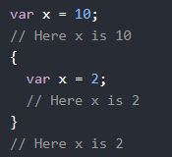
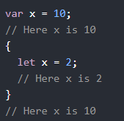
let vs var
The difference between let and var when declaring variables is that let will contain a variable within the scope of the braces it is currently in and var will not Example:
If you use let within curly braces, that variable will only exist between those curly braces

Slide 13
const
If you want to define a read-only variable that will not change its value you can use a const const myName = “Mr. Wolski”; myName = “Dr. Wolski”; //This will cause an error
However, please note that you can still modify arrays and objects that have been defined with const const myNames = [“Mr”,”Wolski”]; myNames.push(“Dr.”); //This is allowed myNames.pop(); //This is also allowed

Slide 14
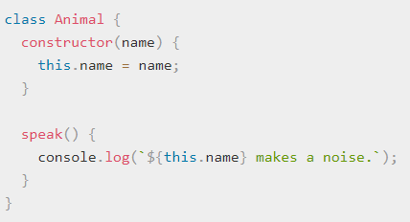
Classes (object oriented JavaScript)
There are many frameworks that have taken advantage of JavaScript’s newer classes features
You can now create classes, have a constructor, provide getters and setters and have classes extend other classes in the usual object oriented fashion
Let’s take a look at a simple example from mozilla:

Slide 15
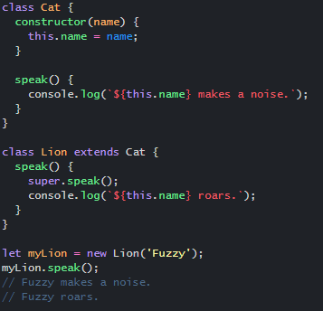
Extending Classes
If we want to inherit the functions from a class but refine or add to them, we can extend a class
You can also use the super keyword to reference the function or value from a class that you inherited from
Check out the example in this jsfiddle and run it to see what happens

Slide 16
Export and Import
It is now possible to split your code into modular files and then export and import them from one place to another
This is called using “Modules” and is very well explained here

Slide 17
Running examples without getting CORS errors – we need a server
To run the example files you downloaded for the JS import/export examples we will need a server to avoid CORS errors
For that, we need a server
we can run local servers using python
If you need to install it https://www.python.org/downloads/

Slide 18
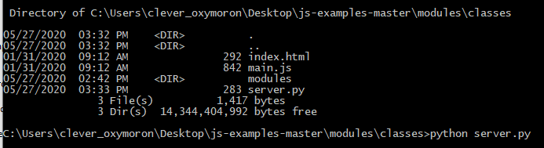
Starting the Server
Download the zip file importExportClassesExample.zip from blackboard
Open up a terminal window and navigate to the folder where you unzipped the files
Enter the command python server.py

Slide 19
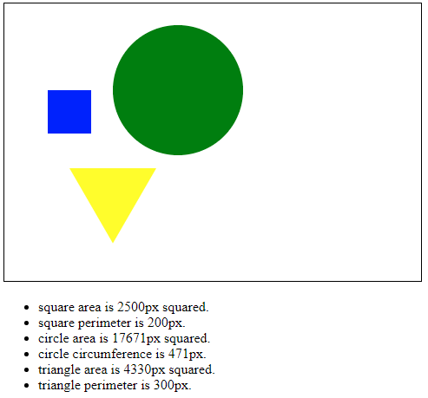
Seeing the example
When you navigate to http://localhost:1337/ you should now see the result

Slide 20
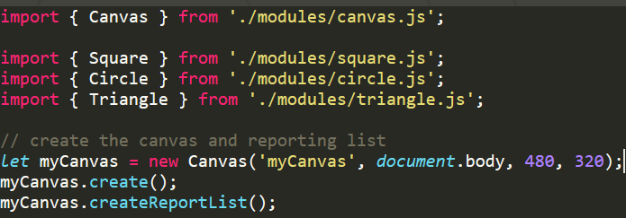
Looking at the code
When you take a look at the code you will notice that we are importing the shapes that are being drawn into the main.js file main.js
We then create a new Canvas object and draw our shapes onto it

Slide 21
Challenges for you
Can you create a new shape (rectangle.js) that extends square?
Have it draw on the canvas along with the other shapes
Can you add some CSS and have the shapes bounce around by implementing the JavaScript from this example https://codepen.io/markuswolski/pen/gOaJybe
Can you add a spin to the shapes so that they rotate as they bounce around?
Instead of bouncing them can you add drag and drop functionality to them?

